Slide 1
EDA Assignment 2 Part 1(A)
5420 Anomaly Detection, Fall 2020
- Harsh Dhanuka, hd2457
Article: Fraud Analytics Using Descriptive, Predictive and Social Network Techniques
- Bart Baesens, Veronique Van Vlasselaer, Wouter Verbeke (Wiley Production)

Slide 2
5420 Anomaly Detection, Fall 2020
- Harsh Dhanuka, hd2457
Key Takeaways
1
5 characteristics associated with challenges related to developing a fraud detection system:
- Uncommon
- Imperceptibly concealed
- Well considered
- Time evolving
- Carefully organized crime
3
A typical organization loses 5% of its revenues to fraud each year.
4
How Big Data helps in Fraud reduction:
Corrective Measures
Preventive Measures
2
Different types of Fraud in today’s world:
Credit Card
Insurance
Corruption
Counterfeit
Warranty
Healthcare, etc
5
Using analytics to solve problems:
Operational Efficiency
Cost Savings
Precision
6
Fraud Analytics Process Model
Fraud Data Scientist

Slide 3
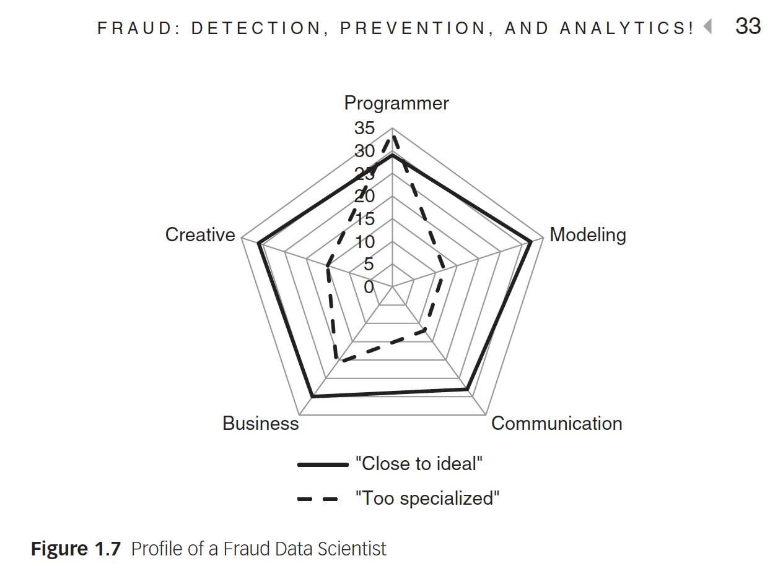
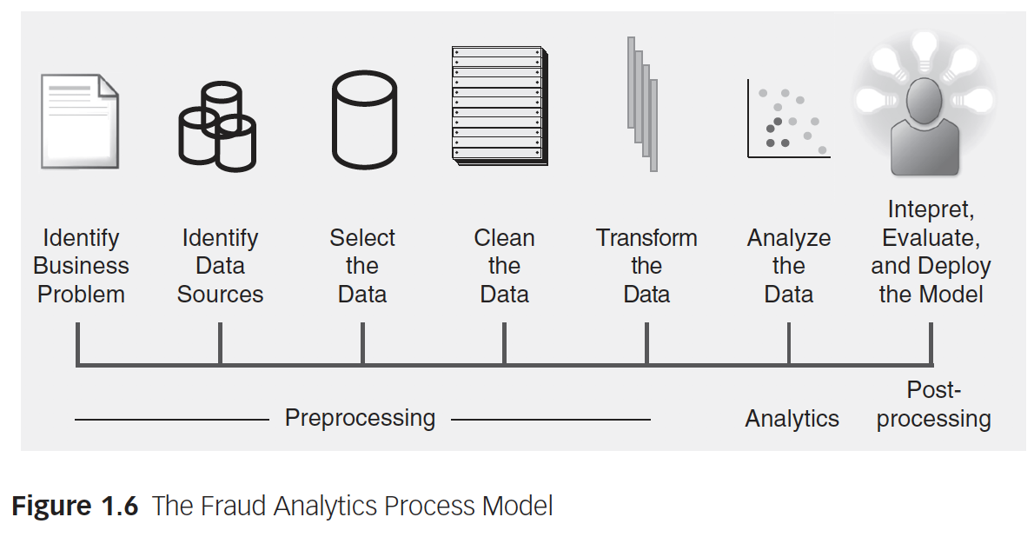
5420 Anomaly Detection, Fall 2020
- Harsh Dhanuka, hd2457
Key Takeaways
Fraud Analytics Process Model
Who is a Fraud Data Scientist?

Slide 4
EDA Assignment 2 Part 1(b)
5420 Anomaly Detection, Fall 2020
- Harsh Dhanuka, hd2457

Slide 5
5420 Anomaly Detection, Fall 2020
- Harsh Dhanuka, hd2457
Initial Approach to data
Initial Data Cleanup
Date/Time Column – convert to month, day
Drop all ID columns
There are many columns which are entirely null or have constant values – DROP them
Convert columns to object/category – Gender, OS Type, Mobile Brands, etc.
Convert Loan Amount to specific categories / bins.
Dummy code the categorical variables – Label Encode
Handling NA’s
Convert all values like -99, -98, -999, -1 to ‘np.nan’. This is because they are counts or days, cannot be negative.
Use the smart ‘Iterative Imputer’ from the sklearn.impute package to impute with ‘Median’.

Slide 6
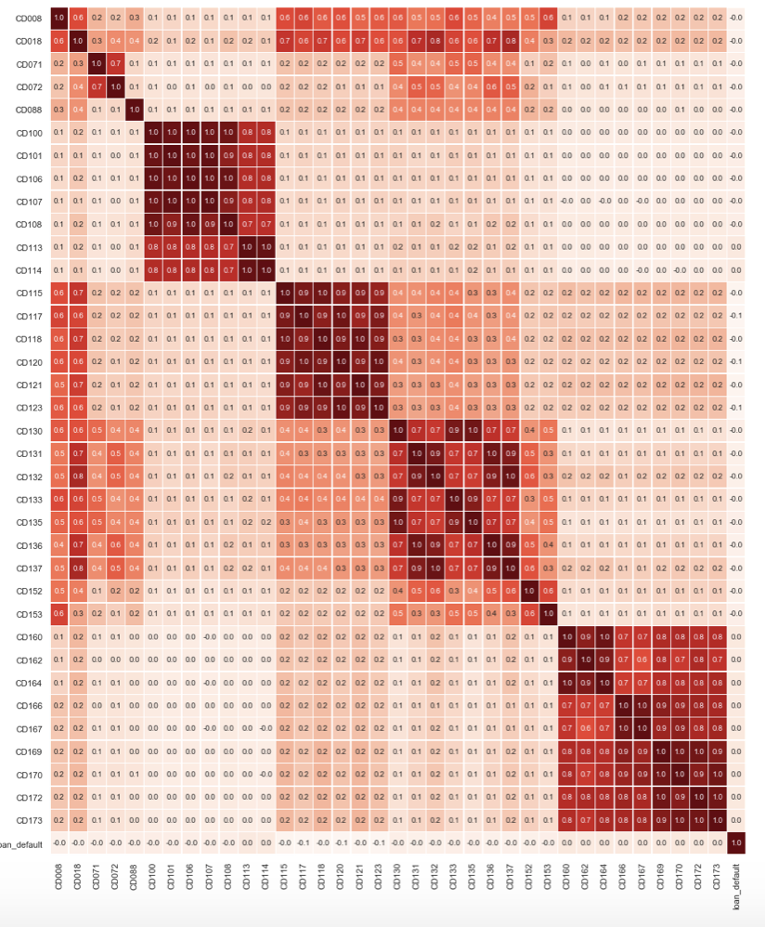
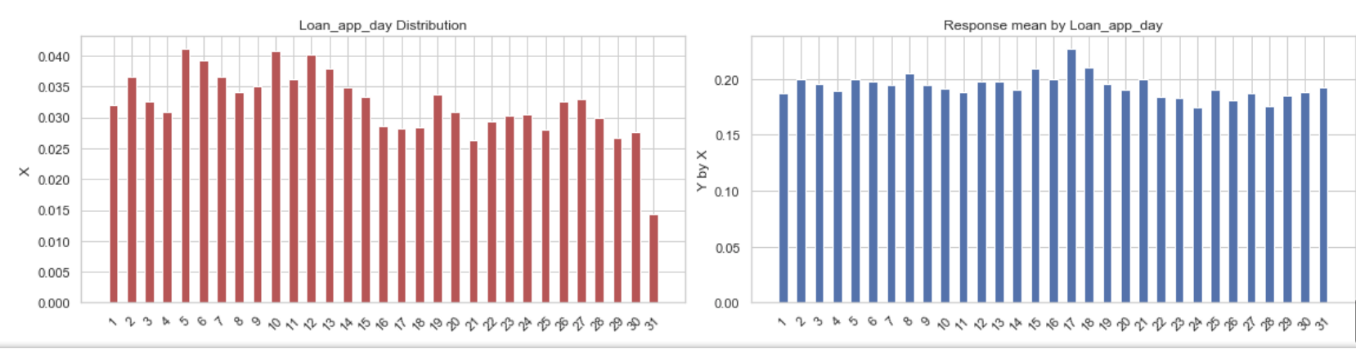
5420 Anomaly Detection, Fall 2020
- Harsh Dhanuka, hd2457
Exploratory Data Analysis
Use ‘qcut’ to bin all numeric/integer variables. This is done for the raw data which has the NA’s. However, I do not use the binned variables for my model. This is just for understanding the data better.
Include the % Y by X graphs, which help get an insight as to whether the variable will be useful.
Check multi-collinearity amongst the variables
Understand the distribution and frequency counts of each variable

Slide 7
5420 Anomaly Detection, Fall 2020
- Harsh Dhanuka, hd2457
Building the Model
1
Feature Selection
Run a basic Logistic Regression and RFE (Recursive Feature Elimination) to identify the n most important features. I do this for n = 15, 20, 30, 40, 50
The best model I obtained was for n = 40 features
2
Business Insights
I select the 17 most important features as per all models, and perform in-depth EDA and list detailed business insights for each
3
Logistic Regression Model
Split data to Train/Test with 25% in test, and build the LR model. Predict values for loan_default.
4
Gains Table, Lift
Using the predicted values, build and show graphically the Lift, ROC, Cumulative Lift, and Komogorov-Smirnov (K-S) line

